Slide 1

AI IN
PERSONAL ASSISTANT
IN THE FUTURE TECHNOLOGY IS DEVELOPING VERY FAST
TAUQUEER ALAM | 12109344 | RK21KAB60
UTSAV KUMAR | 12112304 | RK21KAA36
ANUP KUMAR | 12110948 | RK21KAA12

Slide 2
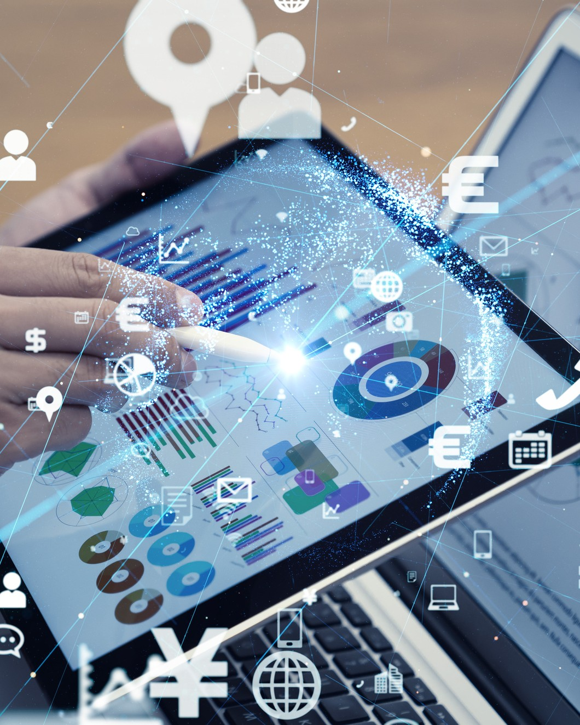
OUTLINE :
Introduction
Objectives
Use Case Diagram
Applications
Methodology
Impact
Future Scope
Conclusions

Slide 3
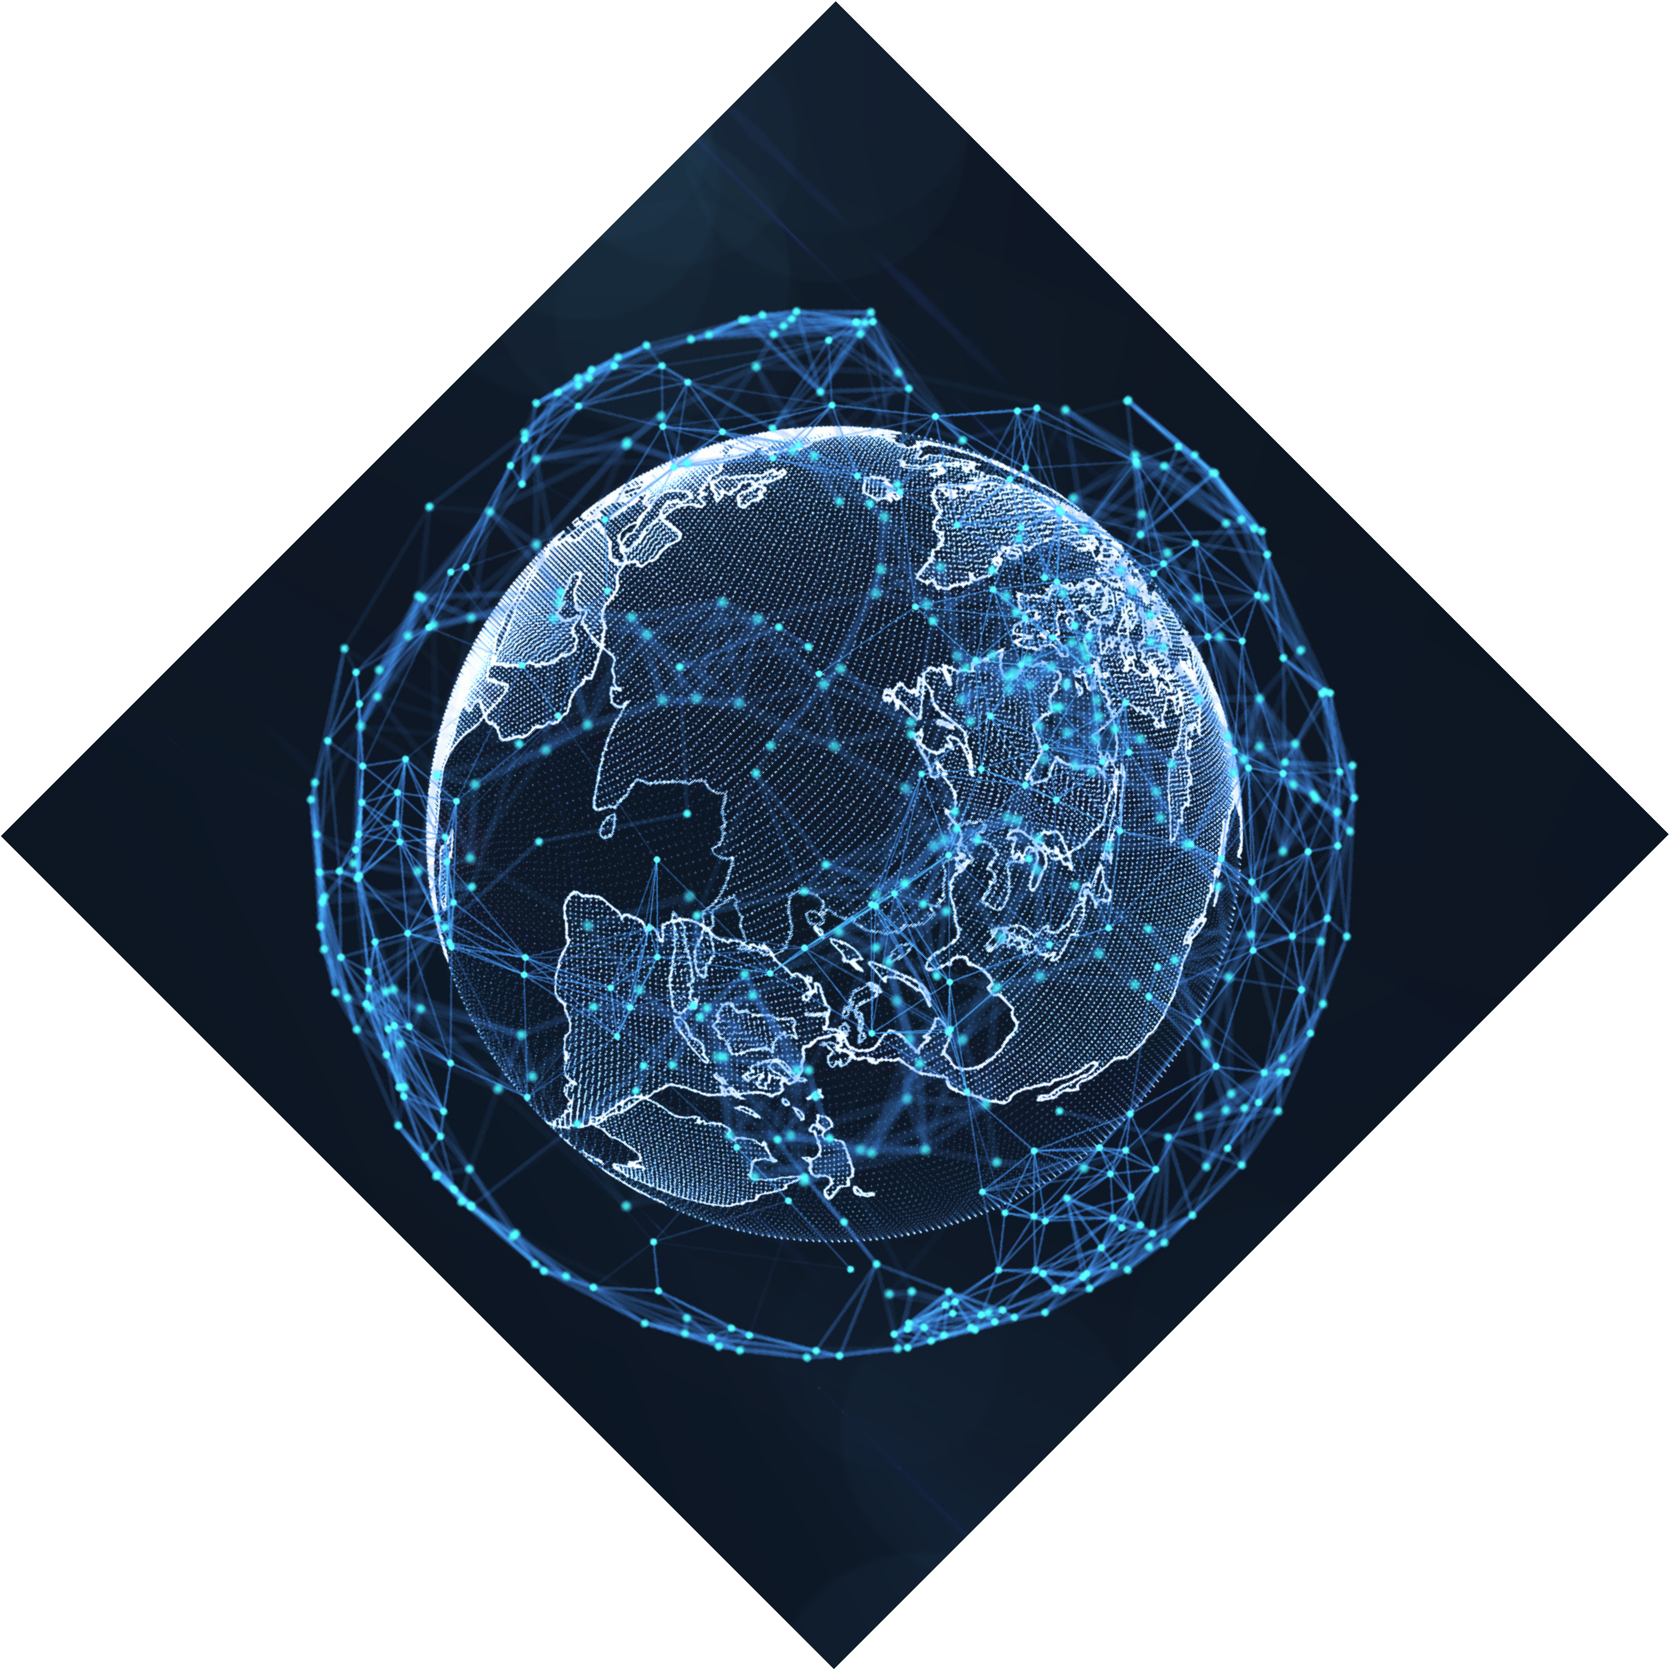
INTRODUCTION
What is Artificial Intelligence:
Artificial Intelligence (AI) is a field of computer science focused on creating machines that can perform tasks that typically require human intelligence, such as learning, reasoning, problem-solving, and perception.
AI involves developing algorithms and models that allow machines to learn from data, make decisions, and perform actions without explicit instructions from a human.

Slide 4
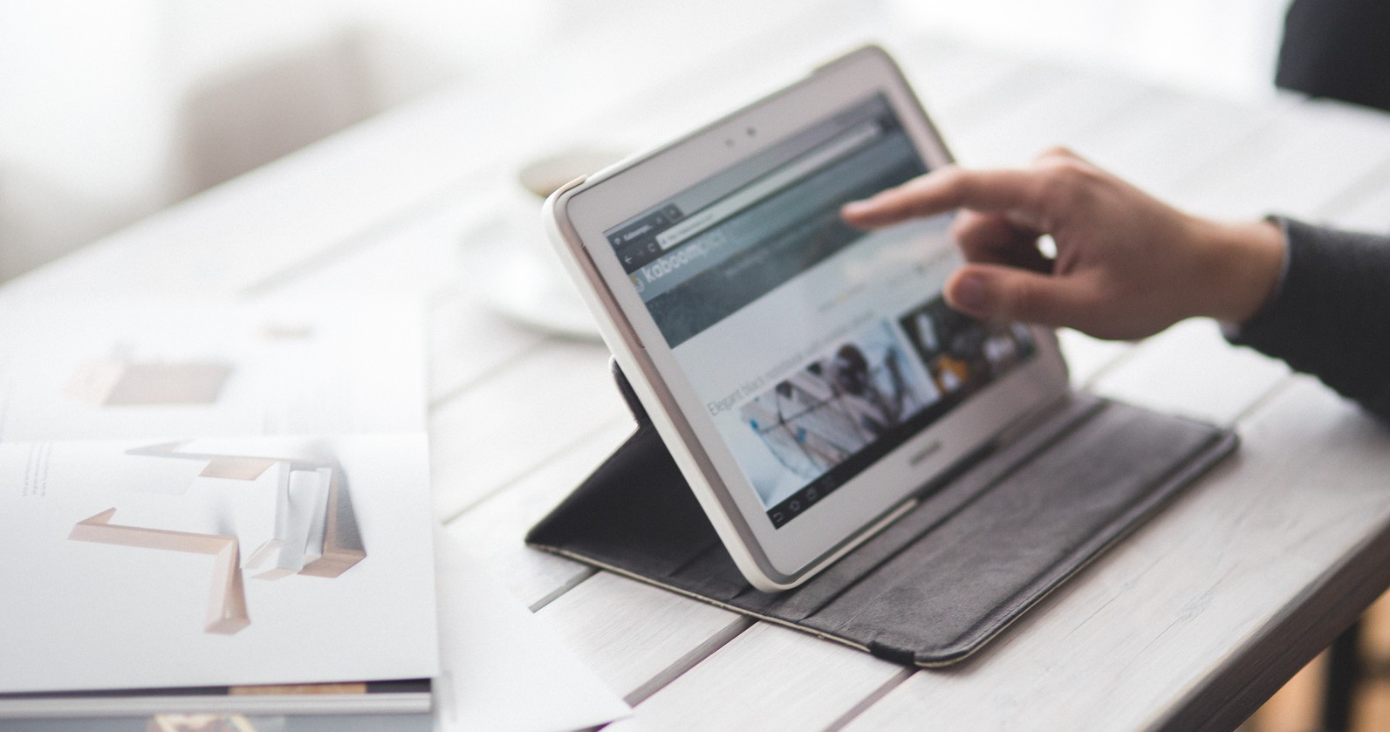

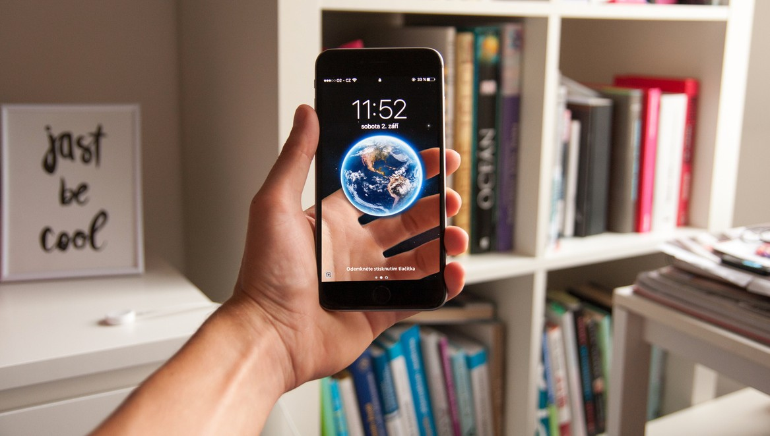

WHAT IS PERSONAL ASSISTANT:
Personal assistant is an application program that understands natural language and voice commands to complete tasks for the users.
Personal assistant is used to perform a typical task like showing date-time, managing emails, open apps, etc. on your command.
Now a days Personal assistant is very useful to human.
It makes human life easier like operate PC’s or laptop on only voice command.

Slide 5


OBJECTIVES
The main objective of a personal assistant is to understand the user’s command, provided in either of the ways, speech or text, and respond to the command accurately in less consumption of time.
Virtual assistants can tremendously save you time. We spend hours in online research and then making the report in our terms of understanding. Your personal assistant can do that for you.
As a Virtual Assistant, It will perform various “administrative tasks” like answering emails, scheduling meetings, making travel arrangements, etc.

Slide 6
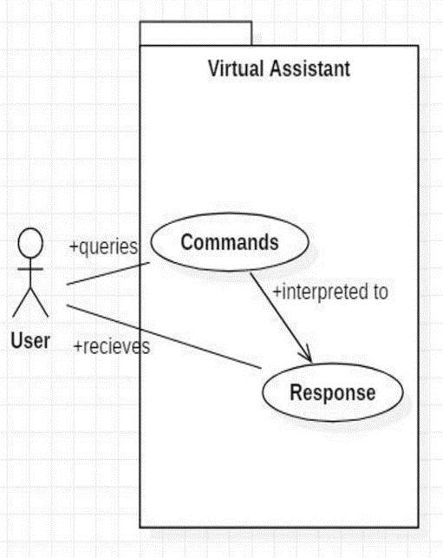
USER CASE DIAGRAM
The user queries a command to the system. System then interprets it and fetches answer. The response is sent back to the user.
CLIK HERE

Slide 7
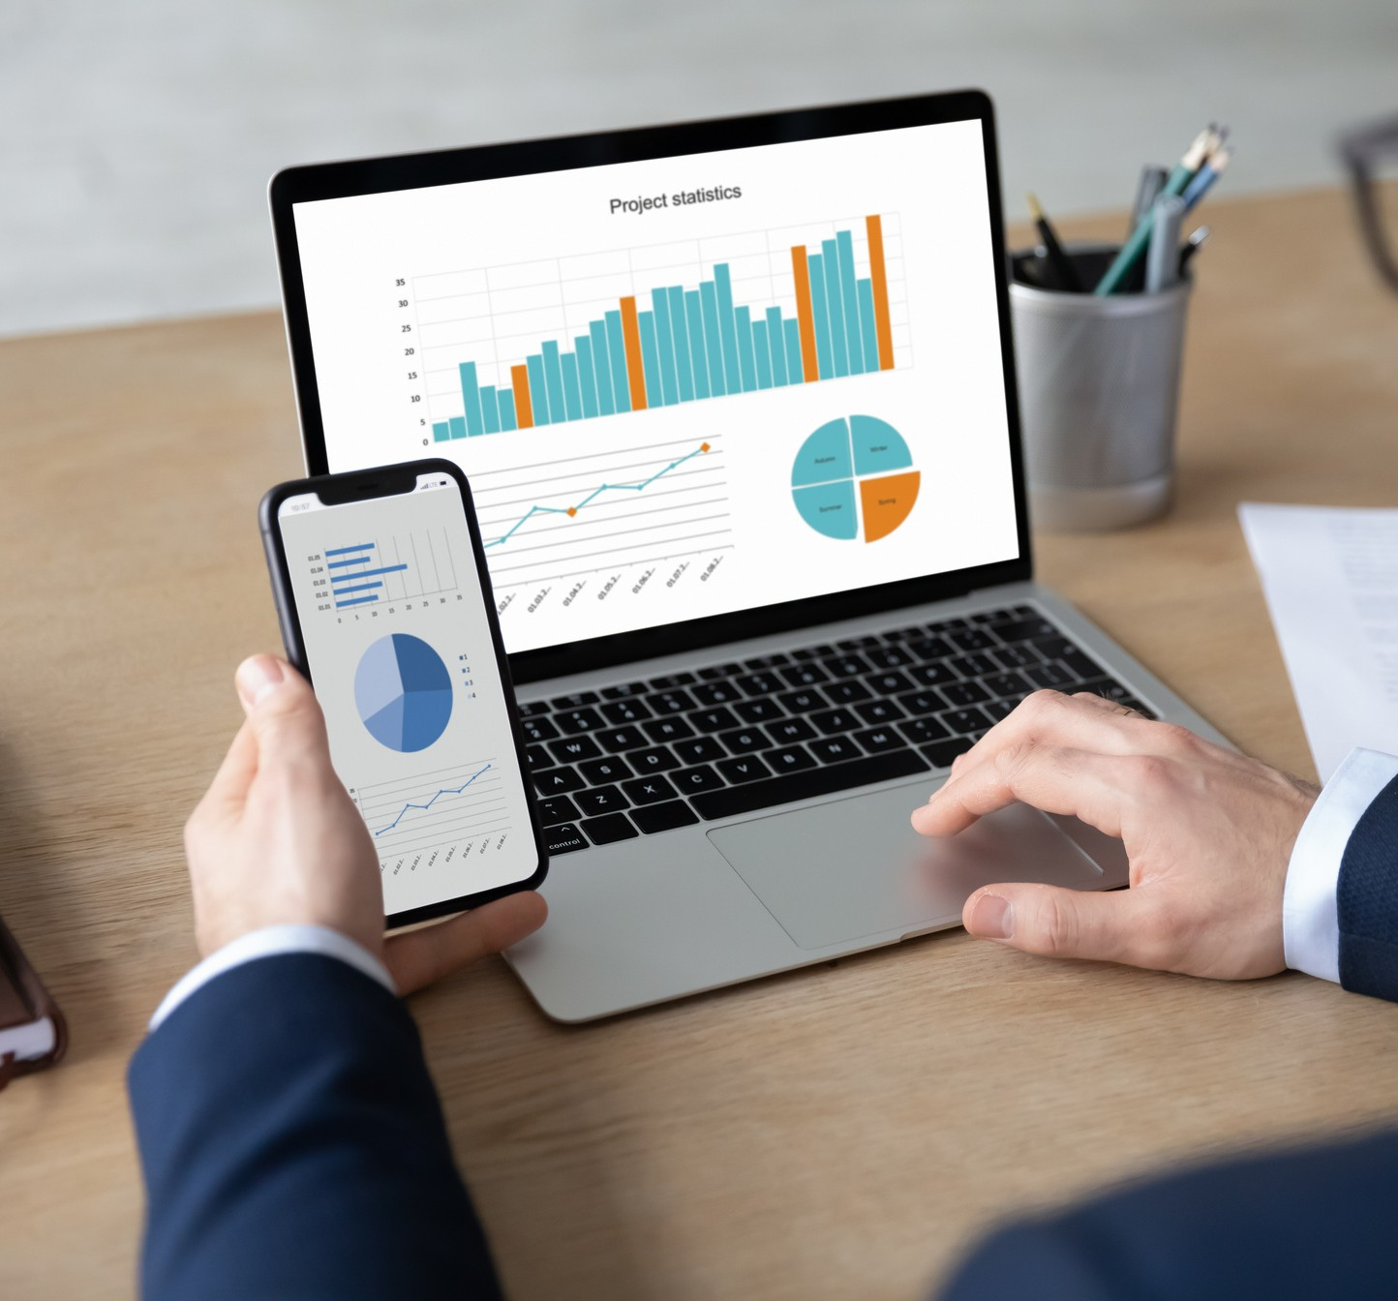

APPLICATIONS OF AI IN
PERSONAL ASSISTANT
Smart Homes Devices (Alexa, Google Fit etc.) Personalized User Experience
Customer Service
Administrative Work(scheduling booking ticket, etc.)
Data Entry
meetings,
CLIK HERE

Slide 8
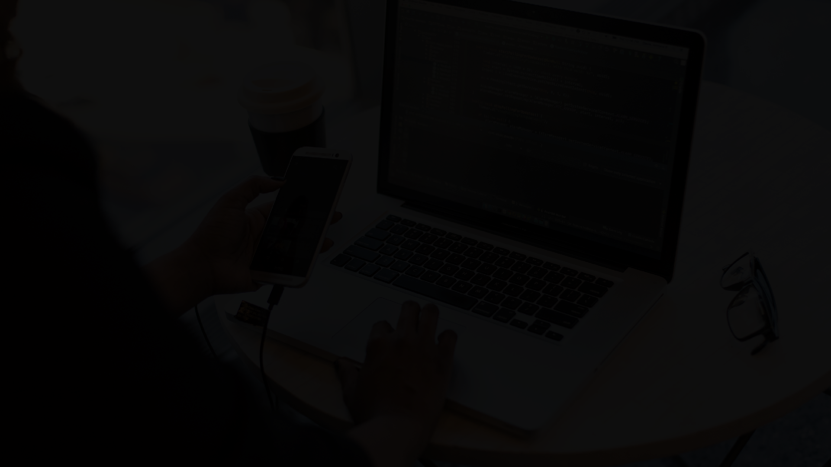
IMPACT
Healthcare: Virtual assistants schedule appointments and enter data into applications easily. It also aids front-office operations by accelerating admissions, discharges, transfers, scheduling patient consultations, and sending and receiving referrals with easy patient medical record updates.
Food: A virtual assistant lets you address your customers’ most frequent queries, reducing order delay time and easing your order tracking process. It provides a contactless experience for your customers, starting with the meal ordering process and ending with safe payment and delivery, offering them a seamless experience throughout.
Travel: Virtual assistants can enable you to guide your customers with trip planning, room types, food, trip notes, safety, medical information, backpacking list, climate, and seasonal information

Slide 9
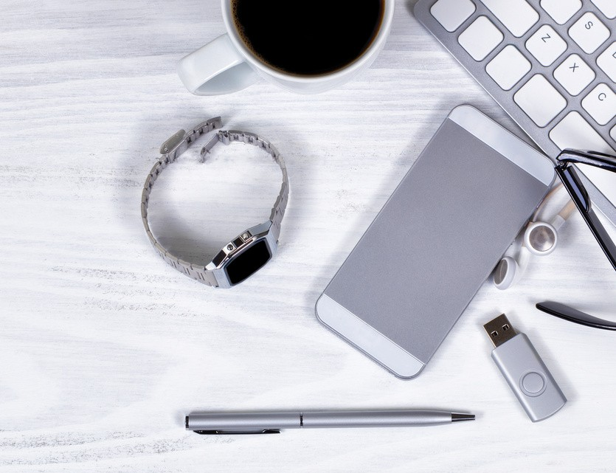
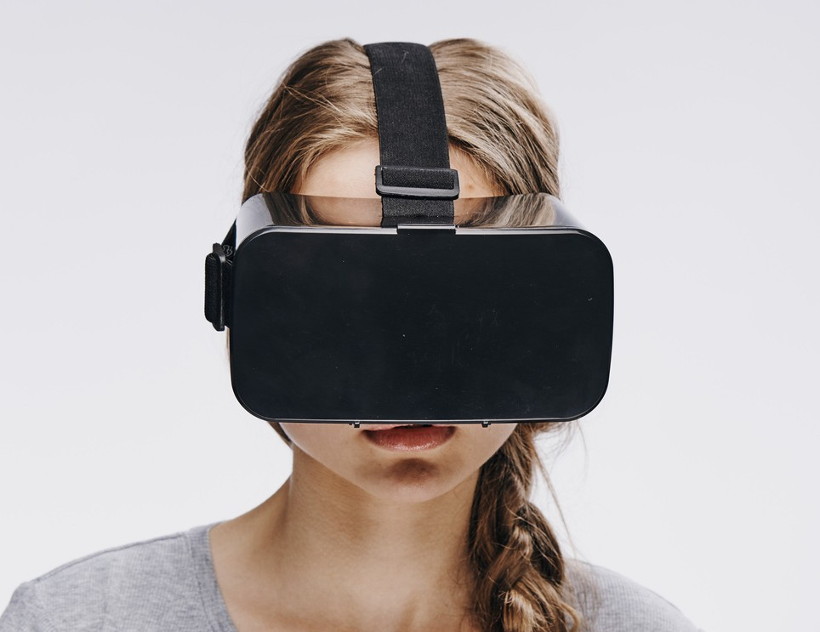
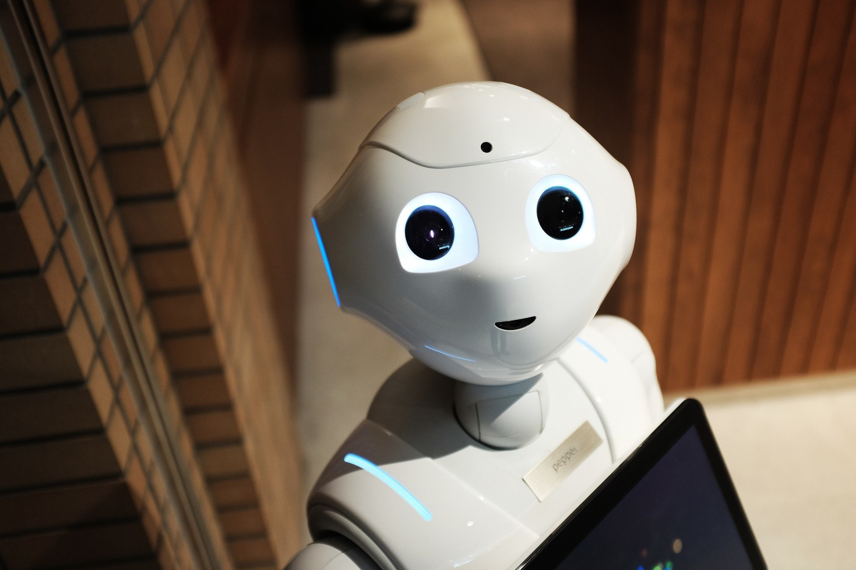

FUTURE SCOPE
Make it easier to gather and share information
Improve Lifestyle
Virtual Assistant(VA) technology has a bright future ahead. In smartphones, they are already capable of scheduling tasks or answering simple questions but in near future You wouldn't need to type, perhaps not even take your phone out of your pocket.
You could simply literally tell your phone to set an alarm for you, call your friend, type a message & send it, play a particular song, auto switch off at a time you need specify

Slide 10

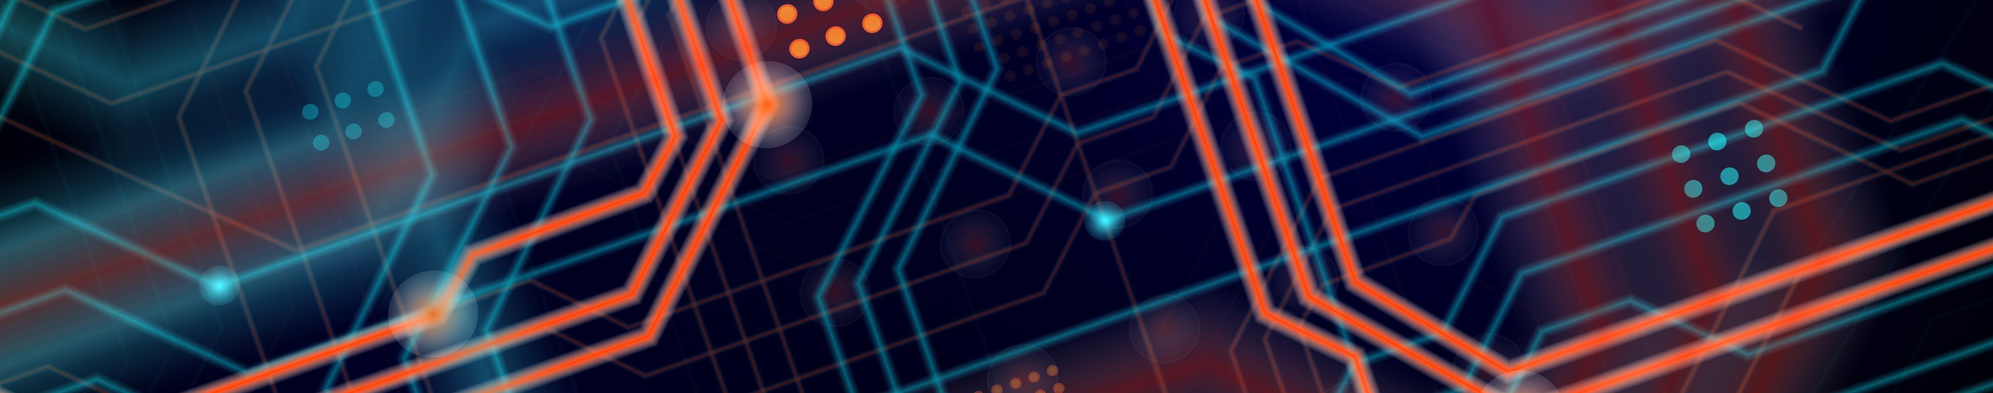
CONCLUSION
Human’s lives are made simpler by virtual assistants. An excellent virtual assistant will save time and money by doing the small tasks for you and doing them accurately and with high quality. If you handle the virtual assistant correctly, it will be a boom in your business.
The major advantage of these virtual agents is that they can undertake jobs that formerly required human expertise, allowing the human employees to offer more value to client encounters by automating routine tasks.
It will reduce workload and will do ones work in just single voice command.
More research is required to better understand the use of these devices according to our findings so far.

Slide 11
Libraries Used:
speech_recognition: Used for speech recognition
os: Used to execute operating system commands
requests: Used to send HTTP requests to websites
pyttsx3: Used for text to speech conversion
pywhatkit: Used to search Google and send WhatsApp messages
datetime: Used to get the current time and date
wikipedia: Used to search for information on Wikipedia
smtplib: Used to send emails
webbrowser: Used to open web pages

Slide 12
Functions:
speak(): Used to convert text to speech
recognize_speech(): Used to recognize speech from the microphone and return the text.
get_time(): Used to get the current time and speak it.
get_date(): Used to get the current date and speak it.
search_google(): Used to search Google for a given query
get_news(): Used to get the top 5 news headlines from Google News and speak them.
send_whatsapp_message(): Used to send a WhatsApp message to a given phone number at a given time

Slide 13
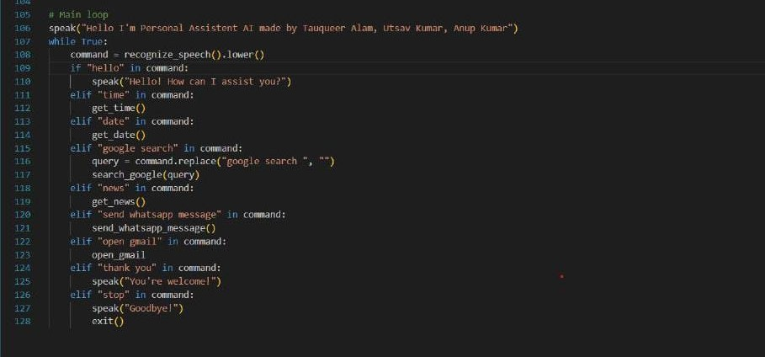
FUNCTION OF OUR PERSONAL ASSISTANT

Slide 14
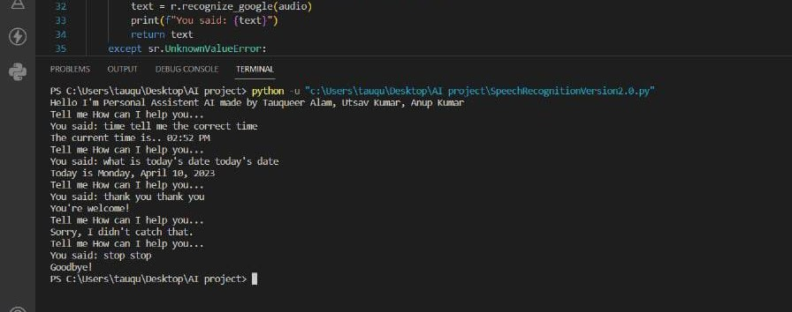
OUTPUT OF OUR CODE

